Slide 1
Analysis of Phoenix, AZ Neighborhoods for Downsizing Assistance Pilot Test
By Patrick Haney
May 17, 2020

Slide 2
Introduction
New service will target 50+ aged homebuyers looking to relocate to accessible neighborhoods
ACME Realty is interested in services/amenities such as
Hospitals / Medical Practices
Walking Trails
Parks
Grocery / Convenience Stores
Wants to build a data understanding of each neighborhood
Would like to know which neighborhoods are similar and how so

Slide 3
Data
Coordinates / Names of all Phoenix, AZ neighborhoods
Started with 15 neighborhoods, ended up with 13 after removing 2 defunct ones
Coordinates of the center of Phoenix, AZ itself
List of up to 100 walking distance venues per neighborhood, each record containing:
Venue Name
Venue Coordinates
Venue Category
Entire dataset had 774 records for venues, and 184 different features once the venue categories were one-hot encoded

Slide 4
Neighborhood Accessibility Rankings
Neighborhoods were ranked based on the density of venues they had which fell under ACME Realty’s desired categories
Venue categories that were adjacent to the target categories were also included in the ranking
Ranking was based on the total amount of ‘desired venues’ that were within 1250 meters (15 minute walk) of the center of the neighborhood

Slide 5
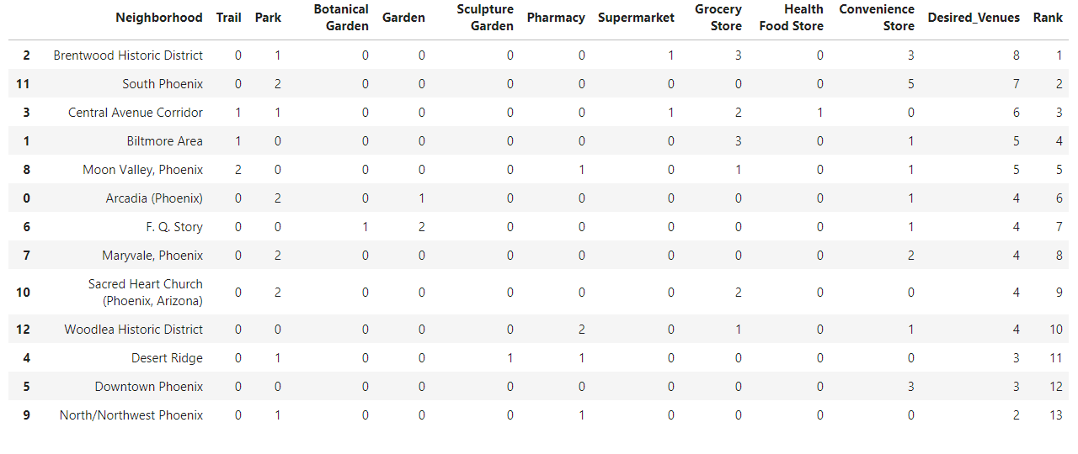
Neighborhood Accessibility Rankings

Slide 6
Neighborhood Profile
Each of the 13 neighborhoods had a data-driven profile built based on the frequency of venue occurrences in the data set
Used mean of the one-hot encoded venue categories to calculate the which categories made up the largest proportions of venues in the neighborhood
Neighborhoods with a higher relative density of grocery stores versus night clubs and bars could help with developing a neighborhood profile
The top 10 most frequently occurring venue categories were discovered and associated with each corresponding neighborhood

Slide 7
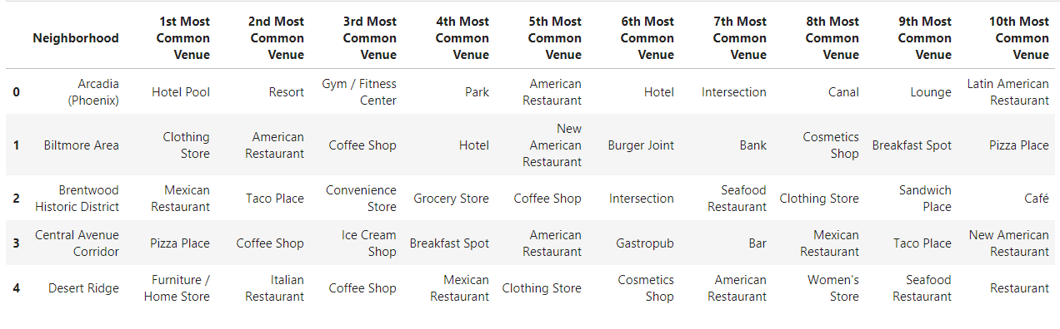
Neighborhood Profile

Slide 8
Neighborhood Clusters
Clustered the full dataset with 13 neighborhoods and 184 features
Used k=5 clusters, as k=3 was not specific enough and k=8 was too specific
The similarities and differences were:
Cluster 0, had an emphasis on Mexican Food, Cafes, and Gay Bars.
Cluster 1 had Pizza Places, American Restaurants, and Coffee Shops.
Cluster 2 had Mexican Food, Convenience Stores, and Fried Chicken Joints
Cluster 3 was very hotel/resort focused, but had parks as well.
Cluster 4 had hardware stores, shipping stores, and Construct & Landscaping services

Slide 9
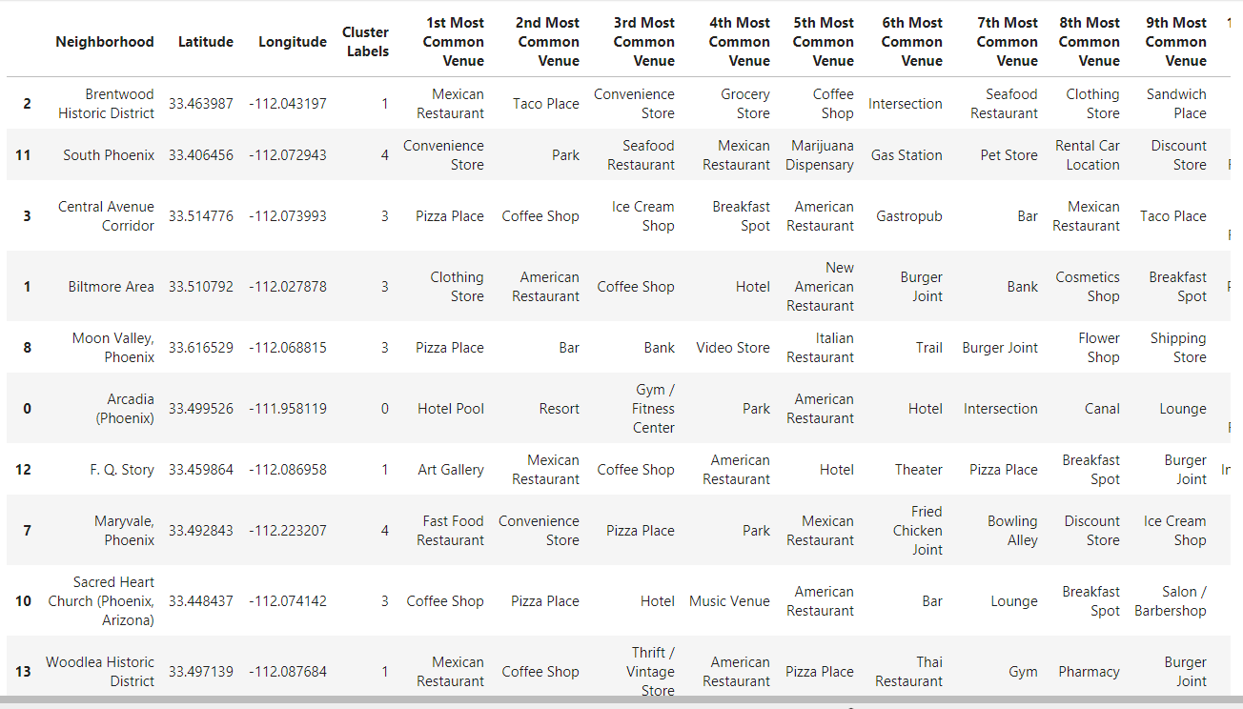
Neighborhood Clusters

Slide 10
Neighborhood Cluster Map
After the clusters were formed and analyzed, they were overlaid on a map of Phoenix
The resulting visual could be used by the realtor as a tool for searching for homes near clusters that have characteristics that the homebuyer likes
Gives an idea of how spread out the neighborhoods are from one another

Slide 11
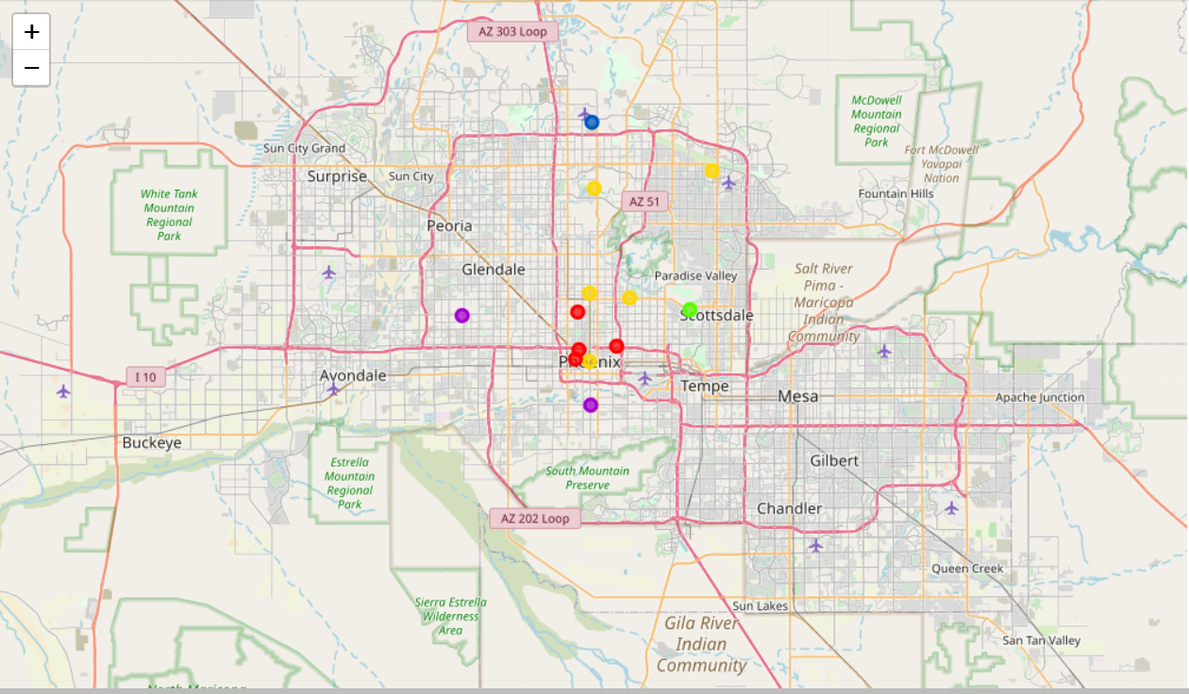
Neighborhood Cluster Map

Slide 12
Conclusion / Next Steps
ACME Realty now has data-driven profiles of each neighborhood in Phoenix, along with accessibility scores, and clusters that define similar / different neighborhoods
The Downsizing Assistance pilot test can utilize this data to either:
Match age 50+ homebuyers up with living spaces prioritized based on their neighborhood convenience rank
Recommend living spaces in neighborhoods that align with the homebuyer’s preferences
A combined approach that factors in convenience and preferences
Once the most effective method is discovered, if it is successful in this market, then the approach and underlying analysis could be scaled to cover multiple cities.

